Slide 1
Robot in wireless networks
Group: Mic(r)otron
Robot name: Moonwalker

Slide 2
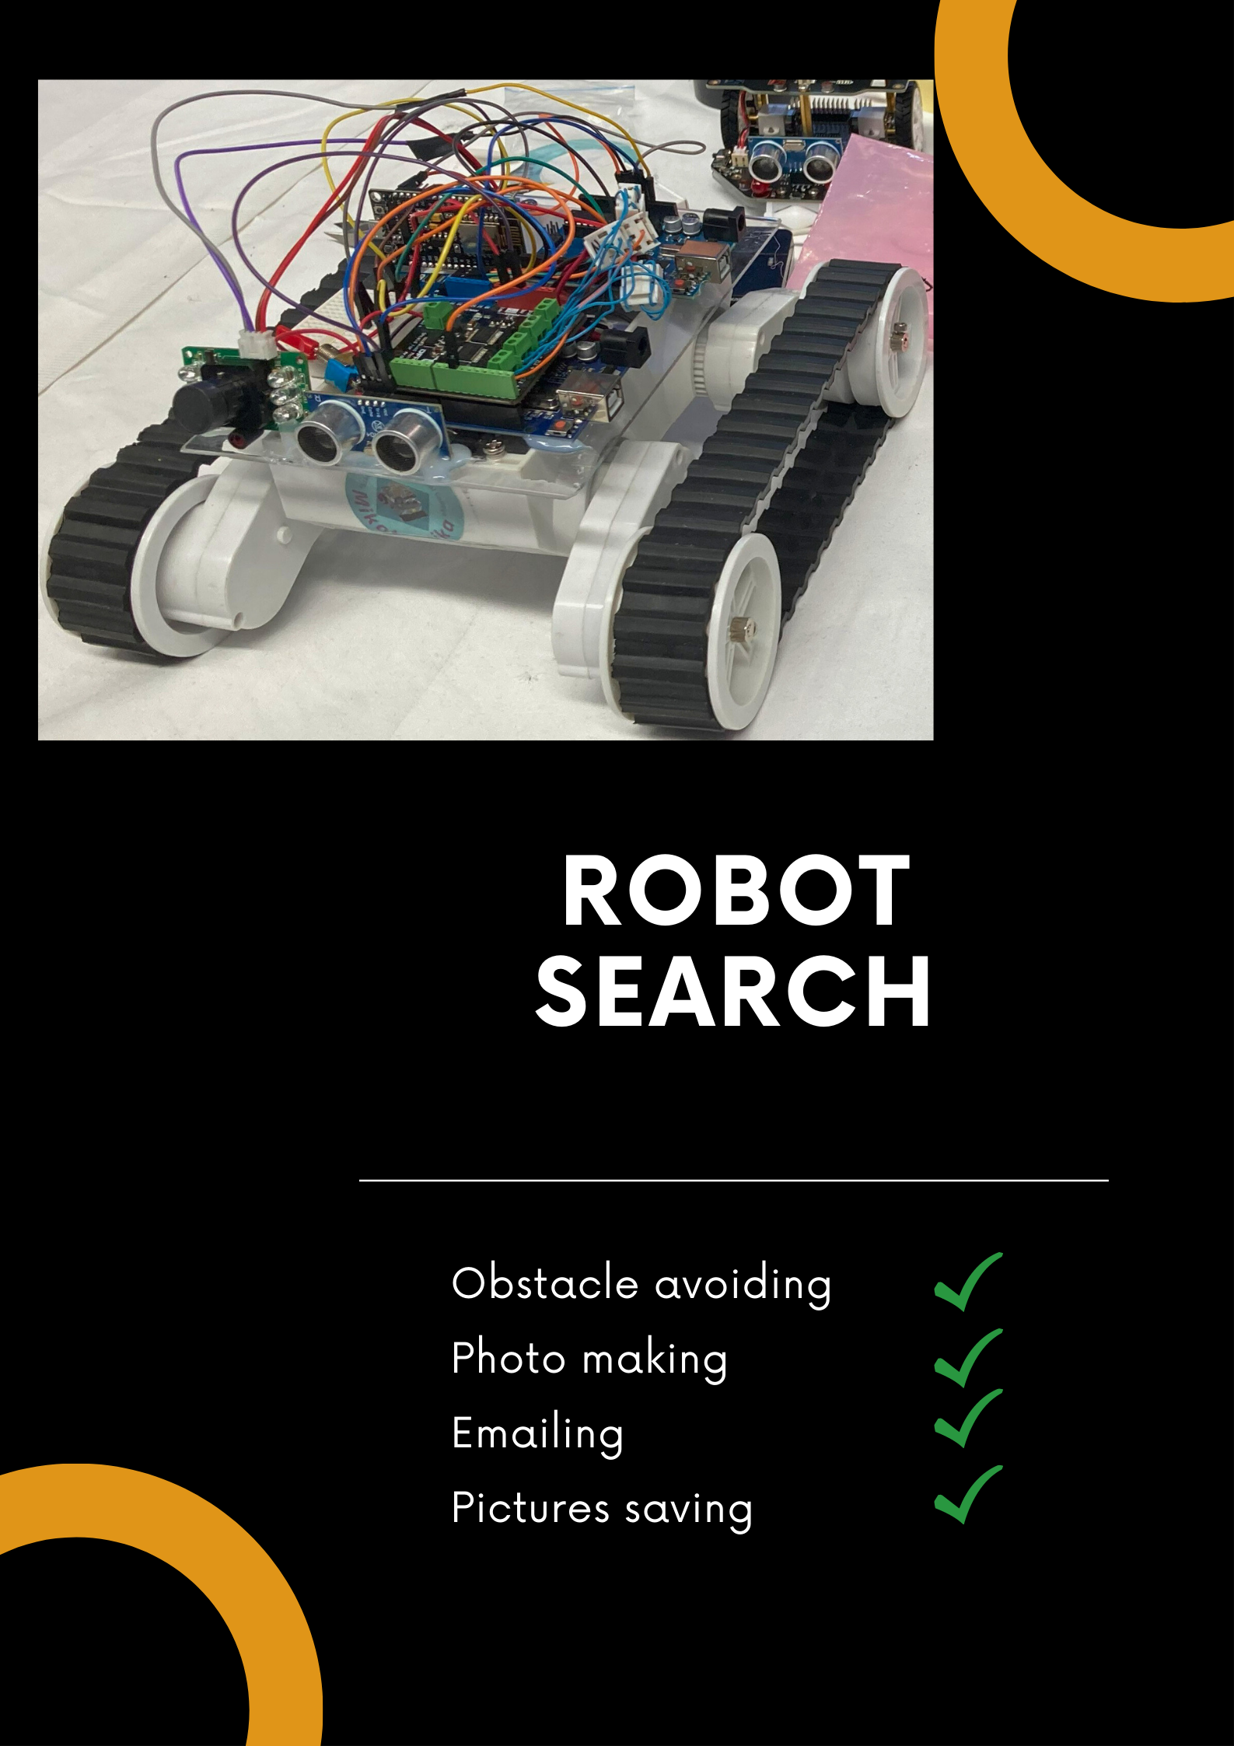
Poster

Slide 3
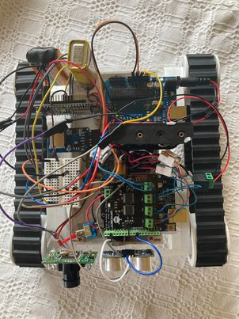
Materials used
ESP8266 NodeMCU
Voltage transformer
SD card
DFRobot motor driver
LinkSprite JPEG Color Camera
Ultrasonic distance sensor

Slide 4
Purpose
01
Send pictures in email with SMPT server
02
Avoiding objects, moving on difficult terrain
03
Save images to SD card

Slide 5
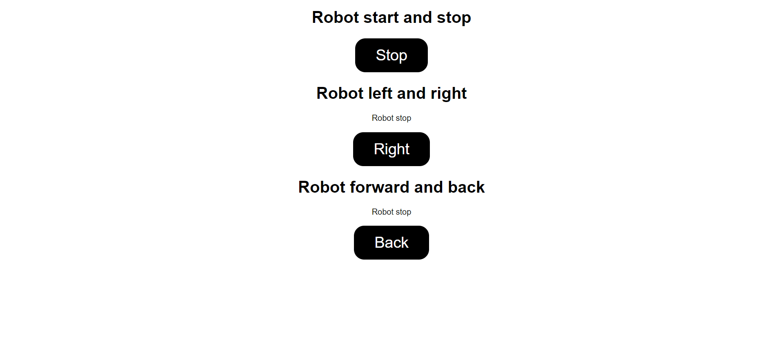
Controlboard

Slide 6
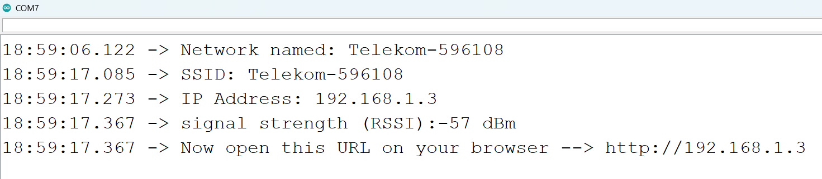
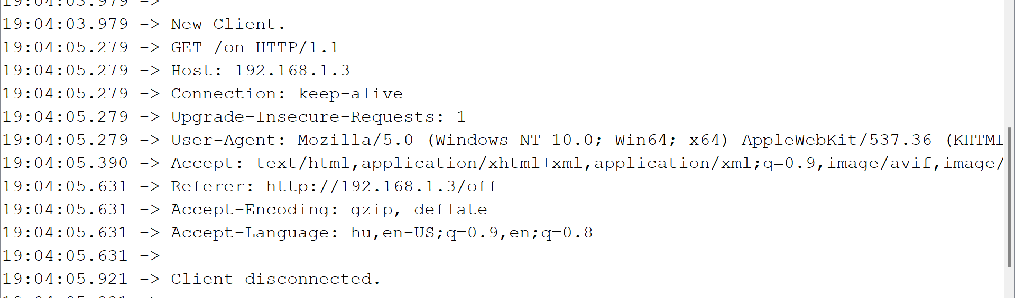
Controlboard

Slide 7
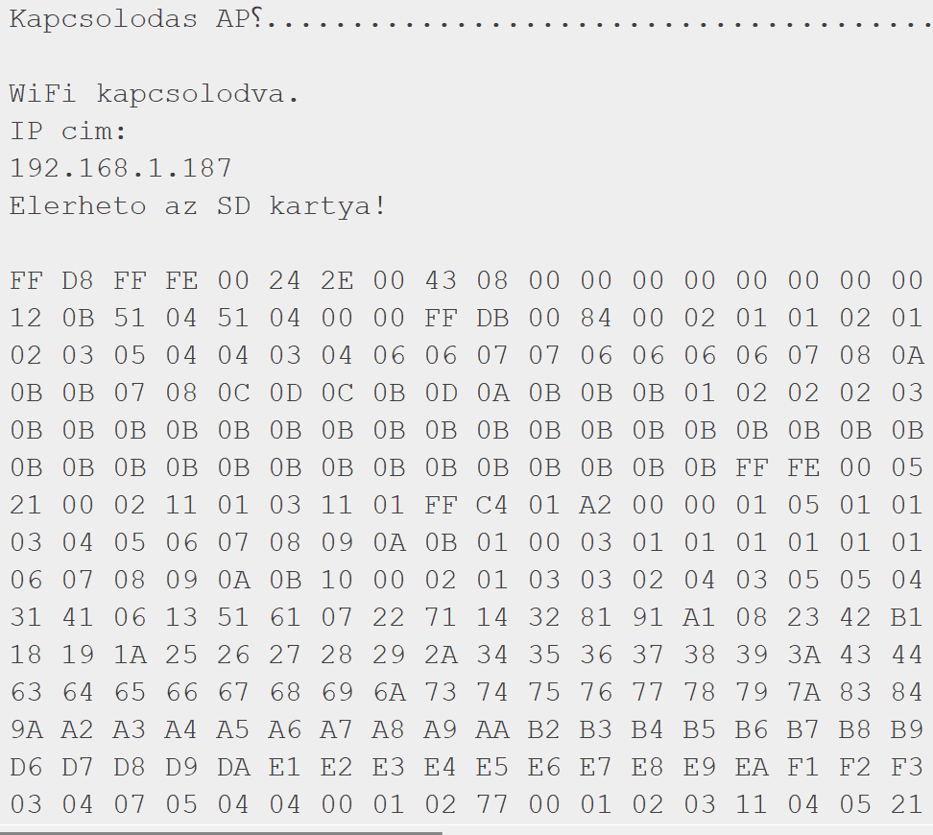
Operation
Connecting to WiFi
Connecting to SD card
Picture in hexadecimal
number system

Slide 8
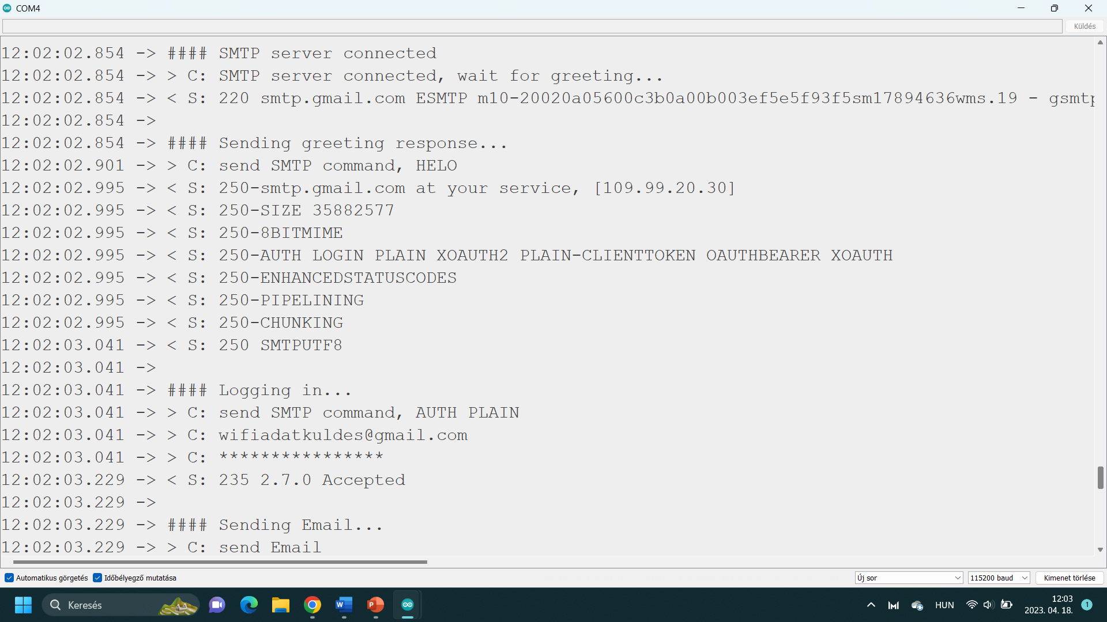
Operation
Connecting to SMPT server
Connecting to sender
e-mail

Slide 9
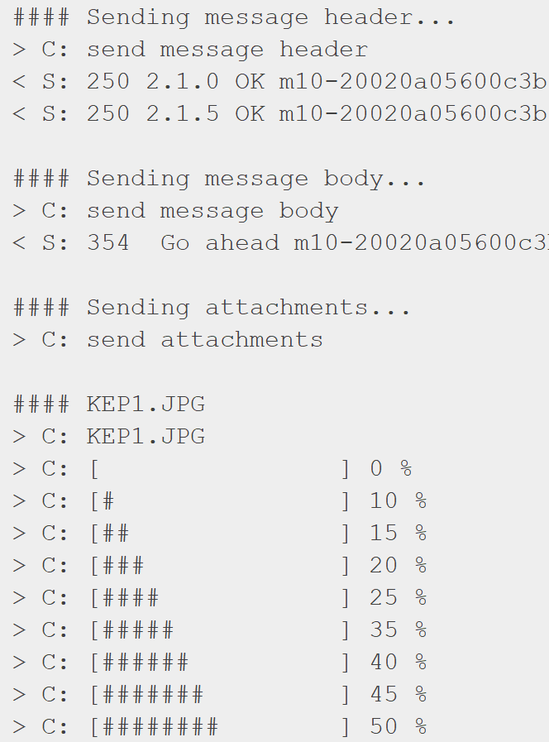
Operation
Send the header
Send the message body
Send the attachments
Upload the photo

Slide 10
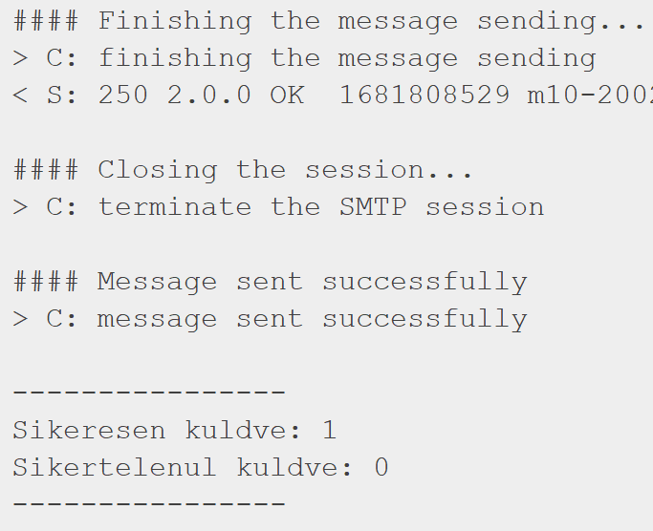
Operation
Send the e-mail
Succesing rate

Slide 11
Future goals
01
Chassis made of PLA and faster motors
02
Using IR distance sensor and a GPS module
03
Change the Wifi module to a Bluetooth module

Slide 12
THANK YOU
for your attention!

